Slide 1
SEMESTER PROJECT
ATTACK CRAWLER FOR MODERN NETWORKED SYSTEMS
Supervisors:
Yves Roudier
Ludovic Apvrille
Students:
Vo Huynh Dan
Truong Quang Huy

Slide 2
AGENDA
Introduction
Stuxnet Model
Client-Server Protocol
External Search Module on TTool
Demo
Conclusion

Slide 3
INTRODUCTION
Goal
Extract relevant information of threads from Internet sources.
Develop a crawler for collecting data of vulnerabilities
Integrate the data into TTool.
Time
1st Semester : Modeled operation of Stuxnet.
2nd Semester :Designed and implemented a protocol for TTool and the Crawler.

Slide 4
STUXNET MODEL
Based on references from W32.Stuxnet Dossier and Stuxnet Under the Microscope documents.
Divided into sub diagrams:
General Stuxnet diagram
Execute Stuxnet diagram
Inject Stuxnet To Project Files diagram
Modify Programable Logic Controllers (PLCs)
Notes:
Model con Stuxnet 6 slides 7 phut
Cach lam sao ?
+ mo ta tong quan ve mo hinh: mo hinh gom nhung gi, root attack …..
+
Lay cai hinh ra noi ket qua
Noi 4 cai hinh

Slide 5
CLIENT-SERVER PROTOCOL
Objective
Connect TTool and Web Crawler database.
Exchange information.
Secure the information.
Design
Clients – Server
Multithread server.
SSL Socket.
Message
Notes:
Gioi thieu – client server, class message
SSLSocket blab la
Design cua message
Cach thuc hoat dong

Slide 6
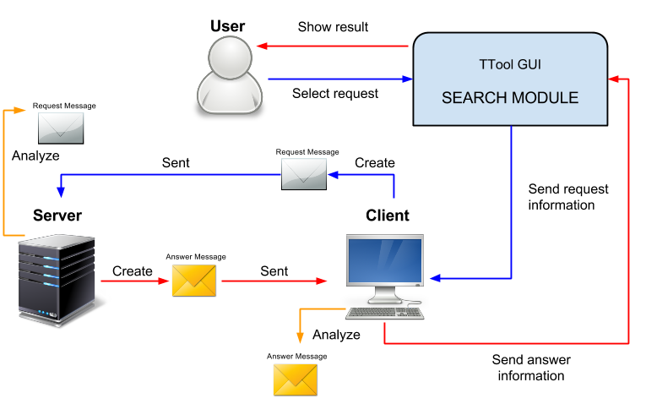
CLIENT-SERVER PROTOCOL
How it works

Slide 7
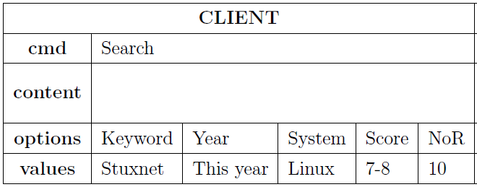

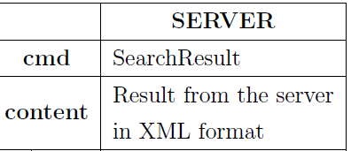

CLIENT-SERVER PROTOCOL
Structure of a message
Request Message
Answer Message
Notes:
Nho noi co bao nhieu loai message
Phu thuoc vao cmd : search, detail, statistics, histogram cho client voi server
Content co the xml hoac bi nary. Thang statistic voi histogram la sai binary

Slide 8
EXTERNAL SEARCH MODULE
Objective
Provide an interface allowing users interact with database server and search engine.
Integrated in TTool source code.
Design
A new JDialog named External Search.
Interact with Google Search engines.
Take advantage of Ttool existing functions.
Notes:
Muc tieu
Design
Co nhung chuc nang gi
Kho khan

Slide 9
EXTERNAL SEARCH MODULE
Features:
Support interaction with components in a diagram.
Separate logical code and presentation code
Character filter
Store configuration in files
Display images in tabs
Decorate results in HTML format

Slide 10
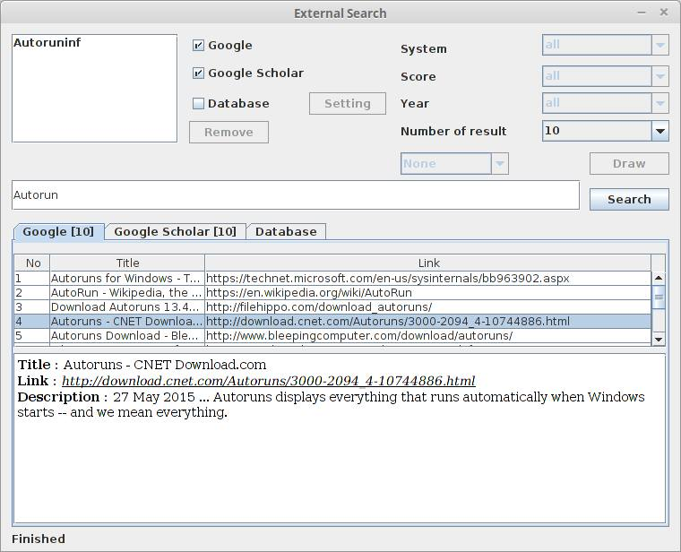

DEMO
Notes:
Show interface
Chay client server
Chay chuc nang search , hien hinh anh
Debug SSL

Slide 11
CONCLUSION
Succeeded in describing Stuxnet attack by a SysML-Sec model.
Designed a friendly user interface which allows users interact with databases for retrieving relevant information.
Implemented a protocol for exchanging messages between users and the web crawler database.
Notes:
Conclusion 1 slide 1p
Finish
knowledge
Future

Slide 12
THANK YOU

